Slide 1

Resume Parsing
By Group 4 :
Dhruvi Ramani
Gokulakrishna
Manan Malhotra
Renu Rawat
Rohit Pawar
Shubham Patel
Mentor: Ms. Bhanupriya

Slide 2
Business Problem : A recruiter needs to go through thousands of resume to find out the best resume as per the job description. This process is tedious, exhausting, and time-consuming.
If this process can be automated where data from multiple resumes can be seen together in a form of table. This will help the recruiter to compare resumes and will also reduce the effort, time and labor.
Business Objective : The aim of this project is to build a feature where a resume is taken as the input and personal, professional, skill set details need to be extracted into a tabular format.
Sample Data Set Details: 79 sample Resumes were provided

Slide 3


Resume Parser
Resume Parsing, is the conversion of a free-form CV/resume document into structured information — suitable for storage, reporting, and manipulation by a computer.
Resume parsers analyze a resume, extract the desired information, and insert the information into a database with a unique entry for each candidate. Once the resume has been analyzed, a recruiter can search the database for keywords and phrases and get a list of relevant candidates.
Text Extraction
Information Extraction

Slide 4





Benefits of ML-based Resume Parsing
Processes various file formats: The ML-based resume parser can process all popular file types including PDF, DOC, DOCX, ZIP, giving candidates the freedom to upload their resume in any format.
Deciphers complex resumes: The ML-based parser recognizes and extracts information from divergent formats. Example: Tabular templates
Machine learning for better accuracy: Optical Character Recognition (OCR) and Deep NLP algorithms to extract text from resumes.
Lightning-fast processing: The ML-enabled parser takes 1-3 seconds to process the most complex of the resumes.
Resume Quality Score: Indexes resume based on their pedigree with AI-backed score, irrespective of the job profile.

Slide 5
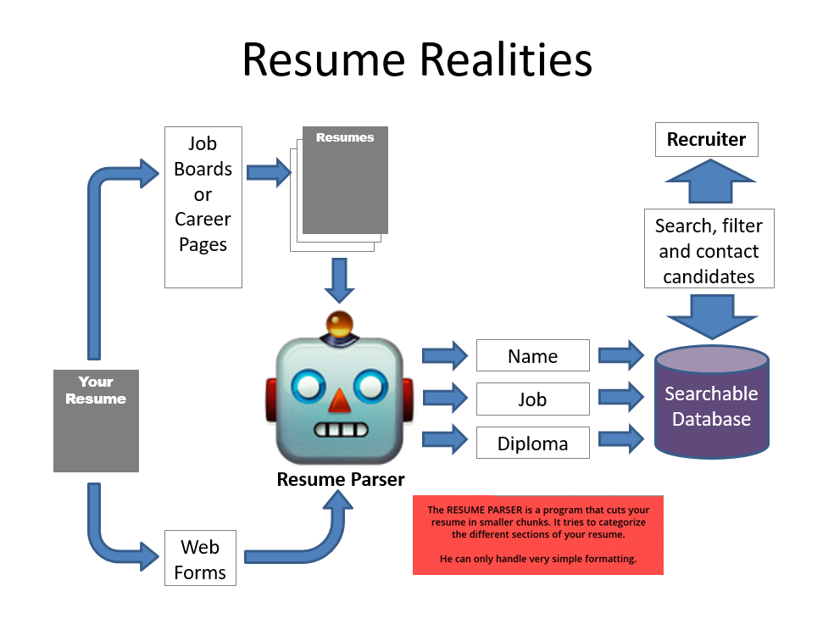
Approaches to create Dataset
Natural Language Processing (NLP)
Python libraries/Python Packages
Predictive Analytics
Regular Expression/Rule Based Parsing
Named Entity Recognition (NER)
Spacy’s NER
BERT NER

Slide 6
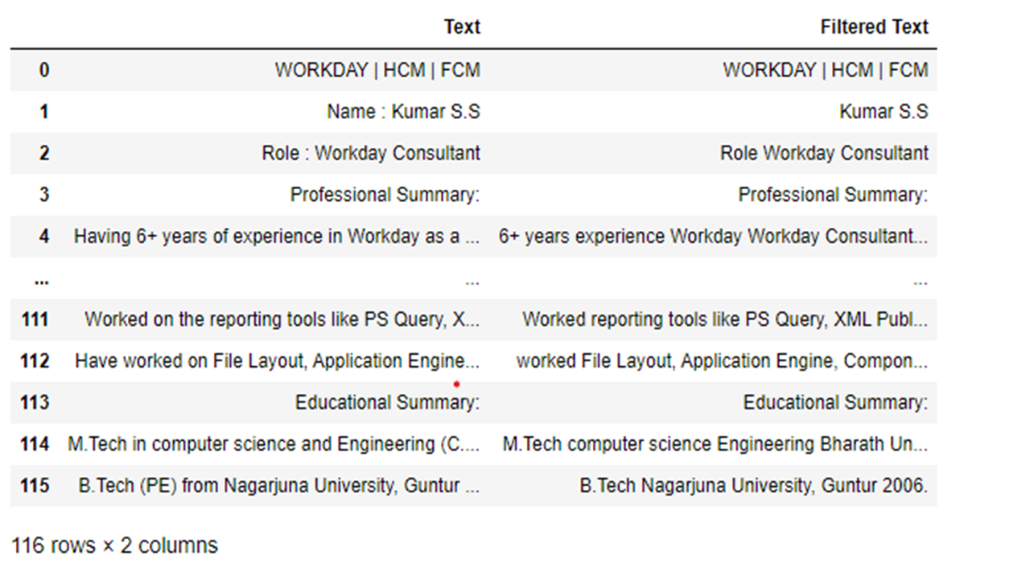
Dataset – Extracted from Resume

Slide 7
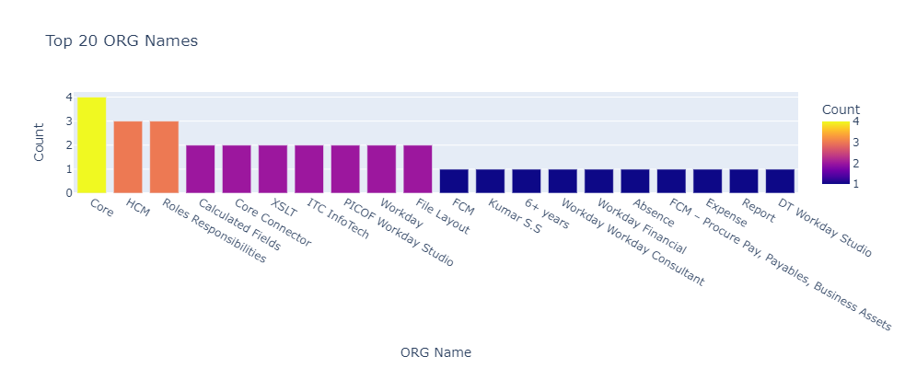
Exploratory Data Analysis

Slide 8
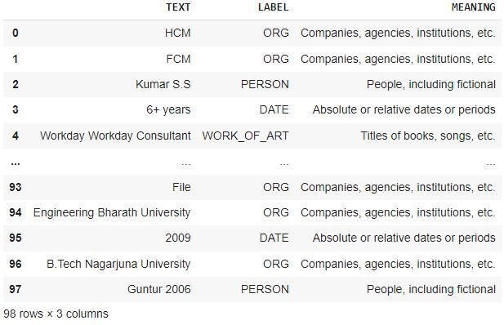
Named Entity Recognition

Slide 9
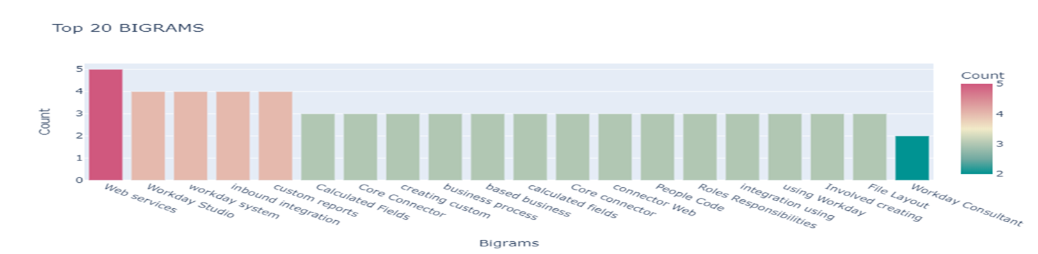
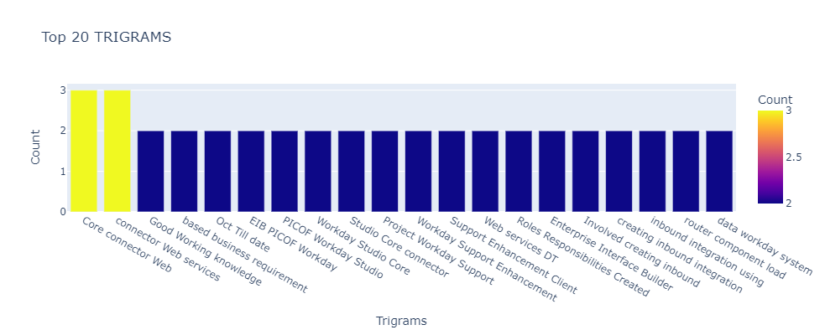
Bigrams & Trigrams

Slide 10
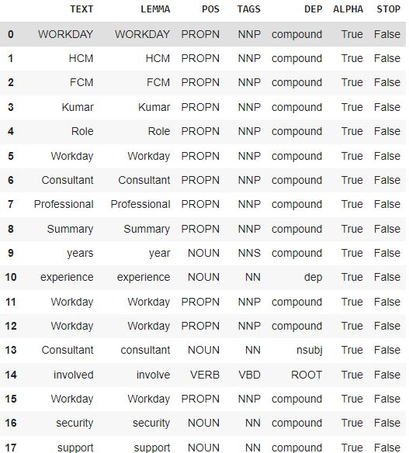
Parts of Speech

Slide 11
Docx
docx2txt
Replaced with Single Space
Multiple spaces
Doc
Data
List
New List
docx2txt
New line
pypdf2
tabs
Pdf
Dataframe
Removed Stop Words
Dataset
Added to filtered text column

Slide 12
Data
Split
List
Defined Restricted Words
newline
First 3 rows
extract
Removed
Name List
extract
Name Extraction

Slide 13
Regex
Resume Text
Email List
search
extract
Email Extraction

Slide 14
Resume Text
Defined Keywords
Skills List
search
extract
Skill Set Extraction

Slide 15
Dataframe
Defined Reserved Keywords
Education List
search
extract
Education Extraction

Slide 16
If
Multiple numbers
Table
Regex
Experience and
(year||years||4digits)
Iterate
Presence
True
Sum
No.of Years
Work Experience Extraction
extract
extract
Pattern Matching
Float digit
List
Experience List

Slide 17
Regex
Resume Text
Phone List
search
extract
Contact No. Extraction

Slide 18
Name List
Final Table
Email List
Skills List
Education List
Work Experience List
Phone List

Slide 19
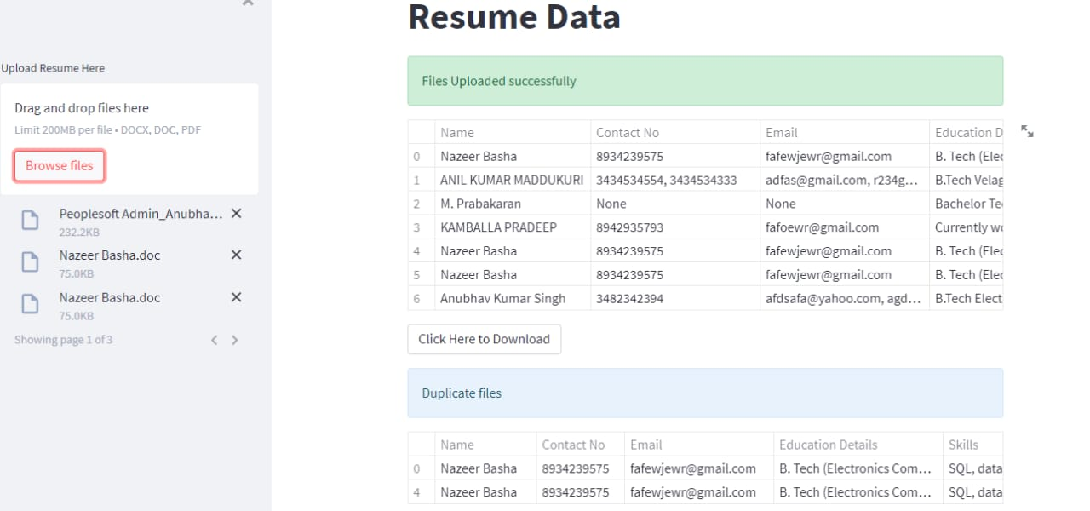
Deployment

Slide 20
Deployment
•Deployment - Streamlit framework
•Multiple or Single resumes upload - file upload widget
•Extracted data from resumes – displayed as Table.
•Duplicate resumes upload - displayed in another table
•Delete – for duplicate files.
•Download - resume data in form of csv file.

Slide 21
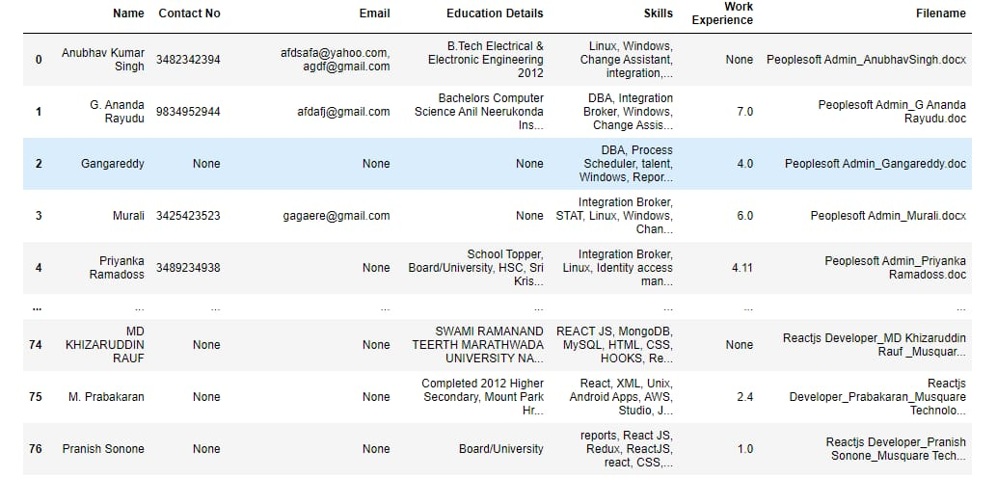
Final table

Slide 22
ThankYou

